Slide 1
RNN Handling sequences
The Seq2Vec architecture is designed to convert a sequence of data into a fixed-length vector representation. This vector can then be used for various tasks, such as classification, prediction, or similarity comparison. Seq2Vec models are commonly used in text classification, sentiment analysis, time-series forecasting, and other tasks involving sequential data. The architecture can be based on RNNs, CNNs, Transformers, or other advanced neural network models. While Seq2Vec is efficient and flexible, it may lose some sequence-specific details when compressing long sequences into fixed-length vectors.

Slide 2
Sequential data
Ordered in time or space
Order of the data points contains
dependencies between them
Examples of sequential data:
Time series
Text
Audio waves

Slide 3
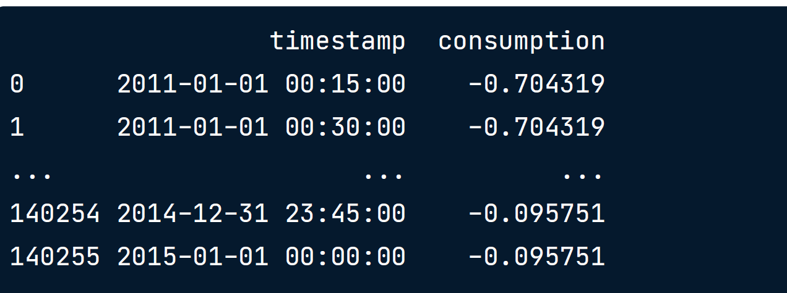
Electricity consumption prediction
Electricity consumption prediction
Task: predict future electricity consumption based on past patterns
Electricity consumption dataset:
Trindade,Artur. (2015). ElectricityLoadDiagrams20112014. UCI Machine Learning Repository.
https://doi.org/10.24432/C58C86

Slide 4
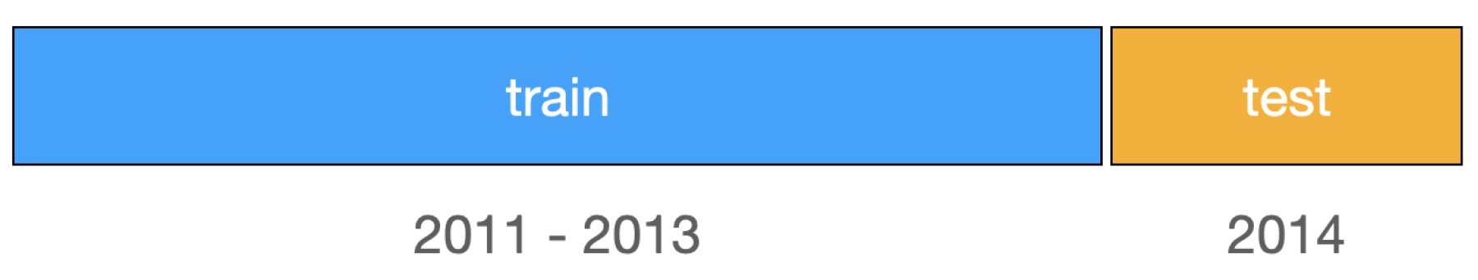
Train-test split
No random splitting for time series!
Look-ahead bias: model has info about the future
Solution: split by time

Slide 5
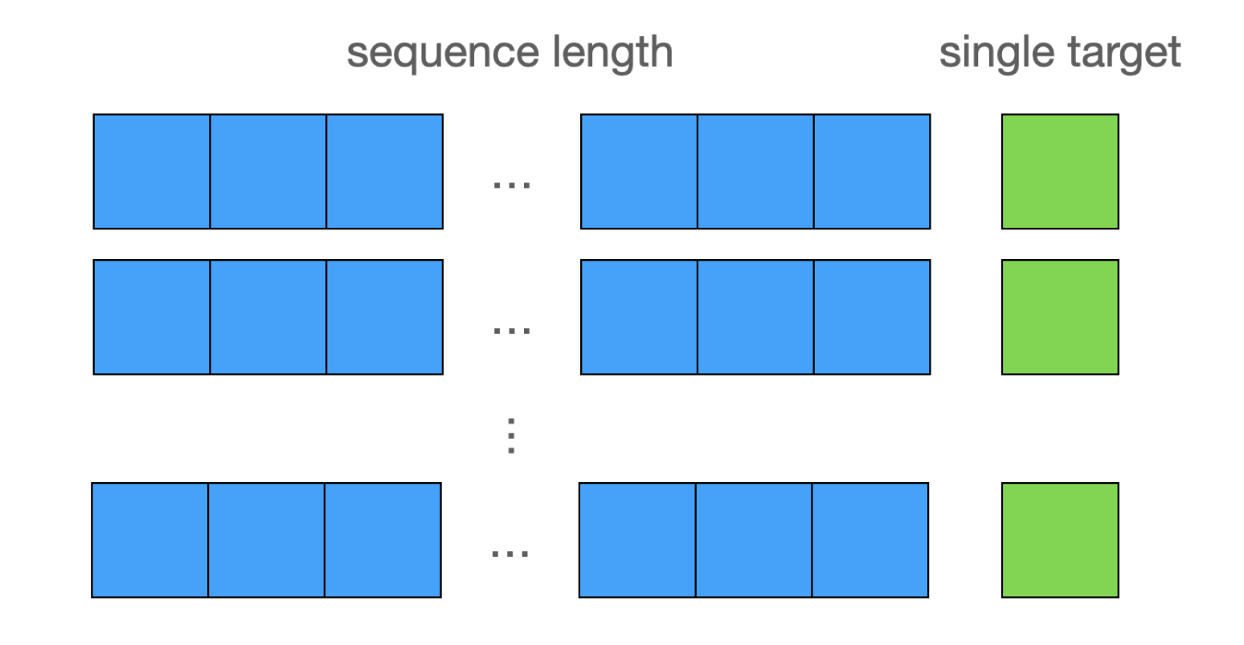
Creating sequences
Sequence length = number of data points in one training example
24 × 4 = 96 -> consider last 24 hours
Predict single next data point

Slide 6
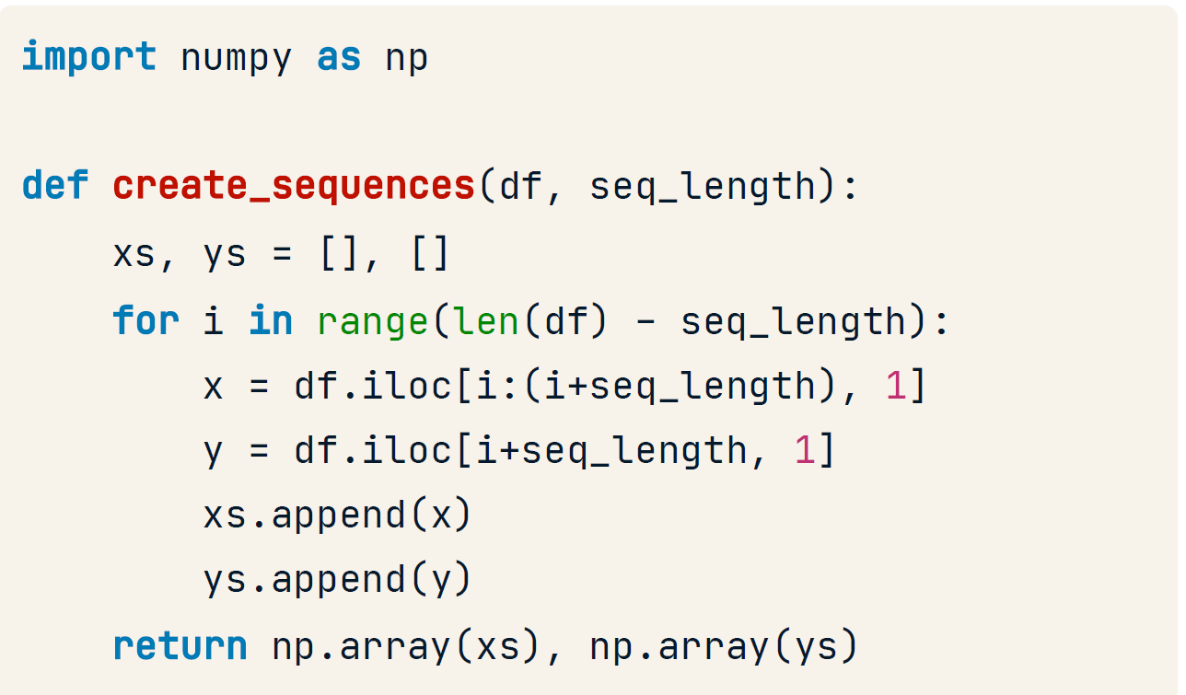
Creating sequences in Python
Take data and sequence length as inputs
Initialize inputs and targets lists
Iterate over data points
Define inputs and target
Append to pre-initialized lists
Return inputs and targets as NumPy arrays

Slide 7
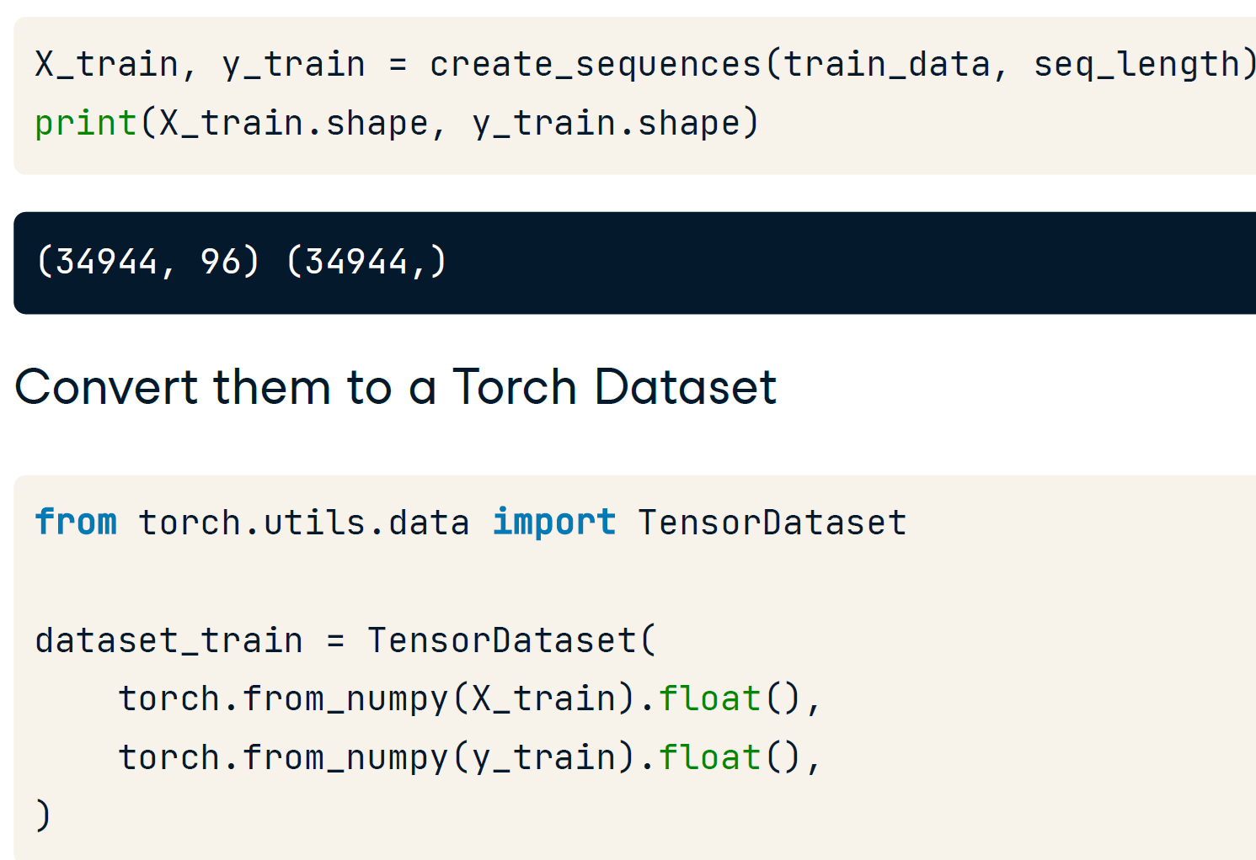
Tensor Dataset Create training examples

Slide 8
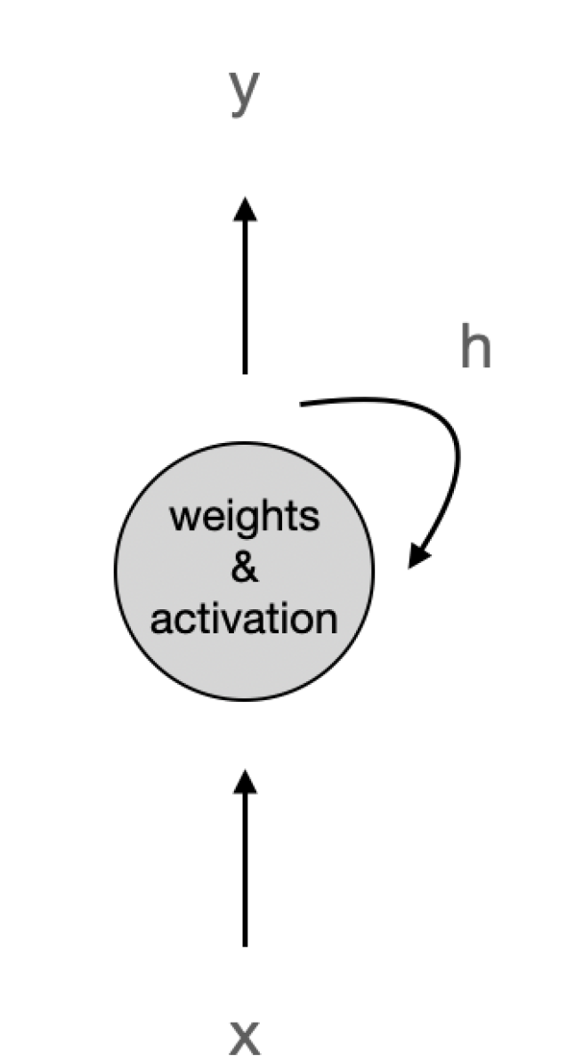
Applicability to other sequential data
Recurrent neuron
Feed-forward networks
RNNs: have connections pointing back
Recurrent neuron:
Input x
Output y
Hidden state h
In PyTorch: nn.RNN()
Same techniques are applicable to other sequences:
Large Language Models
Speech recognition

Slide 9
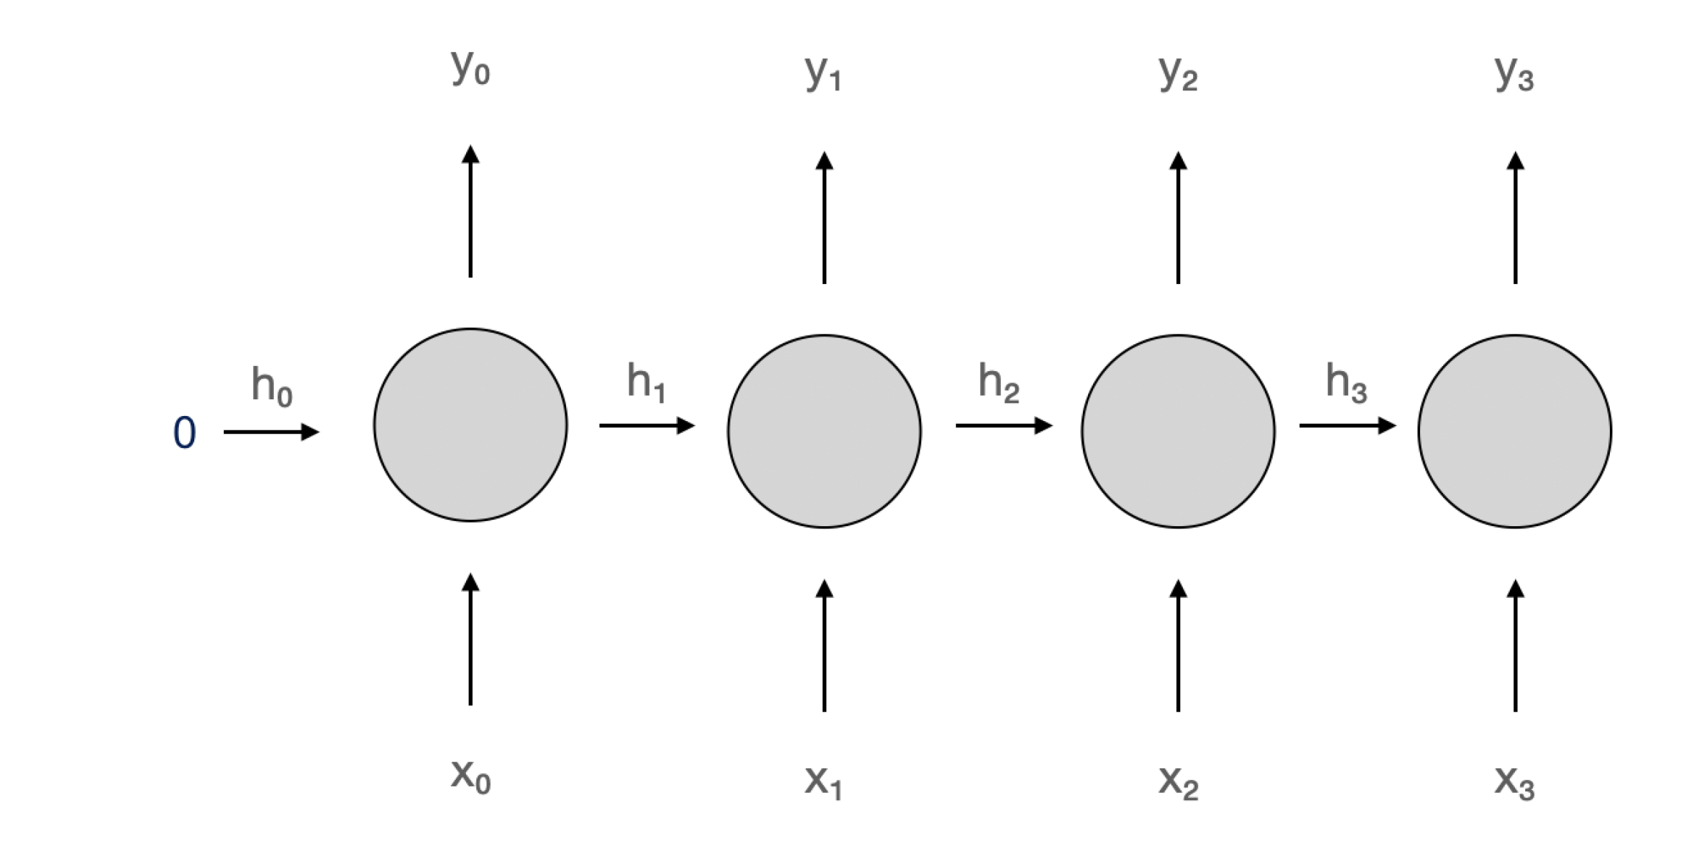
Unrolling recurrent neuron through time
Recurrent Neuron
A recurrent neuron refers to a neuron within a Recurrent Neural Network (RNN). Unlike traditional feedforward neural networks, where information moves in one direction from input to output, RNNs have connections that loop back on themselves, creating a cyclic flow of information. This feedback mechanism allows RNNs to maintain a form of memory, making them particularly effective for tasks involving sequential data.
Key Features of Recurrent Neurons:
Memory: A recurrent neuron has the ability to store previous inputs or states, which influences its output. This makes RNNs highly suitable for time-dependent tasks such as language modeling, speech recognition, and time-series prediction.
Feedback Loop: The recurrent connection allows the neuron to receive its own output from the previous step as part of the input for the current step. This enables it to process sequences of inputs and use context from previous inputs to influence its current output.
Hidden States: Recurrent neurons maintain a hidden state that stores the "memory" of previous computations. This hidden state is updated at each time step based on the current input and the previous state.
Training: Training RNNs can be more complex than feedforward networks due to the vanishing gradient problem. Backpropagation through time (BPTT) is used to train RNNs, where the error is propagated backwards through the network over time, adjusting weights accordingly.
Types of Recurrent Neurons/Networks:
Vanilla RNNs: The simplest form of RNNs, where each neuron in the network has a simple recurrent connection.
Long Short-Term Memory (LSTM): A more advanced form of recurrent neurons designed to overcome the vanishing gradient problem by introducing gates that regulate the flow of information.
Gated Recurrent Units (GRU): Similar to LSTMs, but with a simpler structure that uses fewer gates.
Applications:
Time Series Prediction: RNNs can model time-dependent patterns in data and are used for forecasting future values based on historical trends.
Natural Language Processing (NLP): RNNs process sequences of words in tasks like text generation, machine translation, and sentiment analysis.
Speech Recognition: RNNs are effective in recognizing and transcribing spoken language, as they can process the sequential nature of speech.

Slide 10
Deep RNN

Slide 11
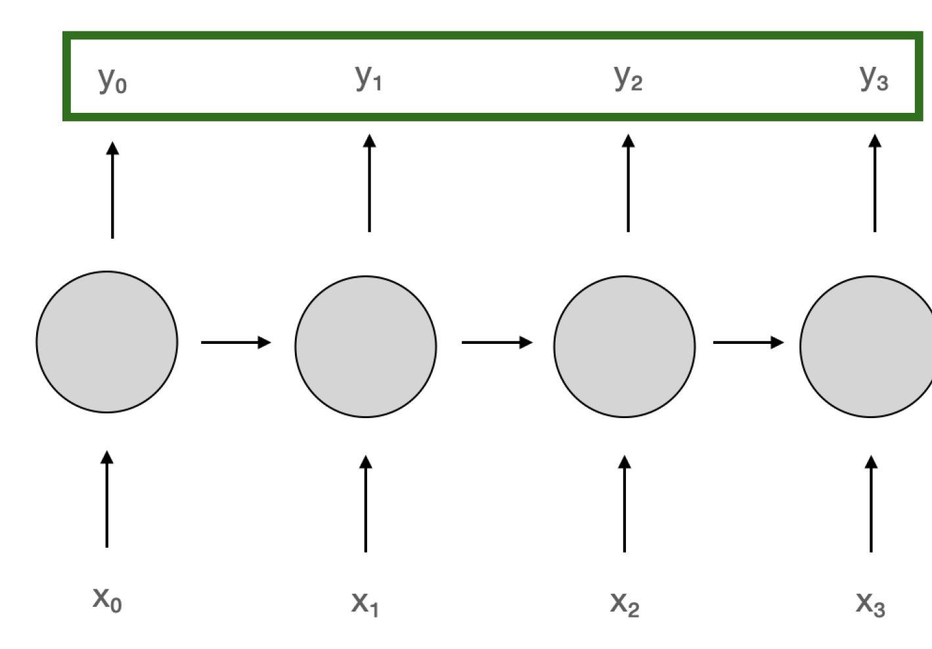
Sequence-to-sequence Architecture
Pass sequence as input, use the entire output sequence
Example: Real-time speech recognition, machine translation, text summarization, speech recognition, and question answering, where the task requires transforming an input sequence into an output sequence.
Many to Many
The architecture typically includes an encoder to process the input and a decoder to generate the output. Advanced techniques like attention mechanisms have been developed to enhance the performance of Seq2Seq models, especially for long or complex sequences. Seq2Seq has found widespread applications in machine translation, speech recognition, and text summarization, among other fields.
Notes:
Sequence-to-Sequence (Seq2Seq) Architecture
The Sequence-to-Sequence (Seq2Seq) architecture is a type of neural network model that is designed to handle sequential data where both the input and output are sequences of variable lengths. This architecture is particularly effective for tasks like machine translation, text summarization, speech recognition, and question answering, where the task requires transforming an input sequence into an output sequence.
Main Components of Seq2Seq Architecture:
Encoder:
The encoder is responsible for processing the input sequence and converting it into a fixed-size context vector (also known as the hidden state).
Typically, the encoder is a type of Recurrent Neural Network (RNN), such as LSTM or GRU, that processes the input sequence step by step.
The encoder reads the input sequence and updates its hidden state after processing each element, essentially "encoding" the sequence's information.
Context Vector:
The context vector is a compressed representation of the entire input sequence. It contains the most important information needed for the decoder to generate the output sequence.
In vanilla Seq2Seq models, this vector is passed directly from the encoder to the decoder. In more advanced versions, this can be dynamic (as in attention mechanisms).
Decoder:
The decoder is responsible for generating the output sequence from the context vector produced by the encoder.
Like the encoder, the decoder is typically an RNN (LSTM or GRU), which takes the context vector and starts producing the output sequence step by step.
At each step, the decoder uses the context vector and its previous output to predict the next element of the output sequence.

Slide 12
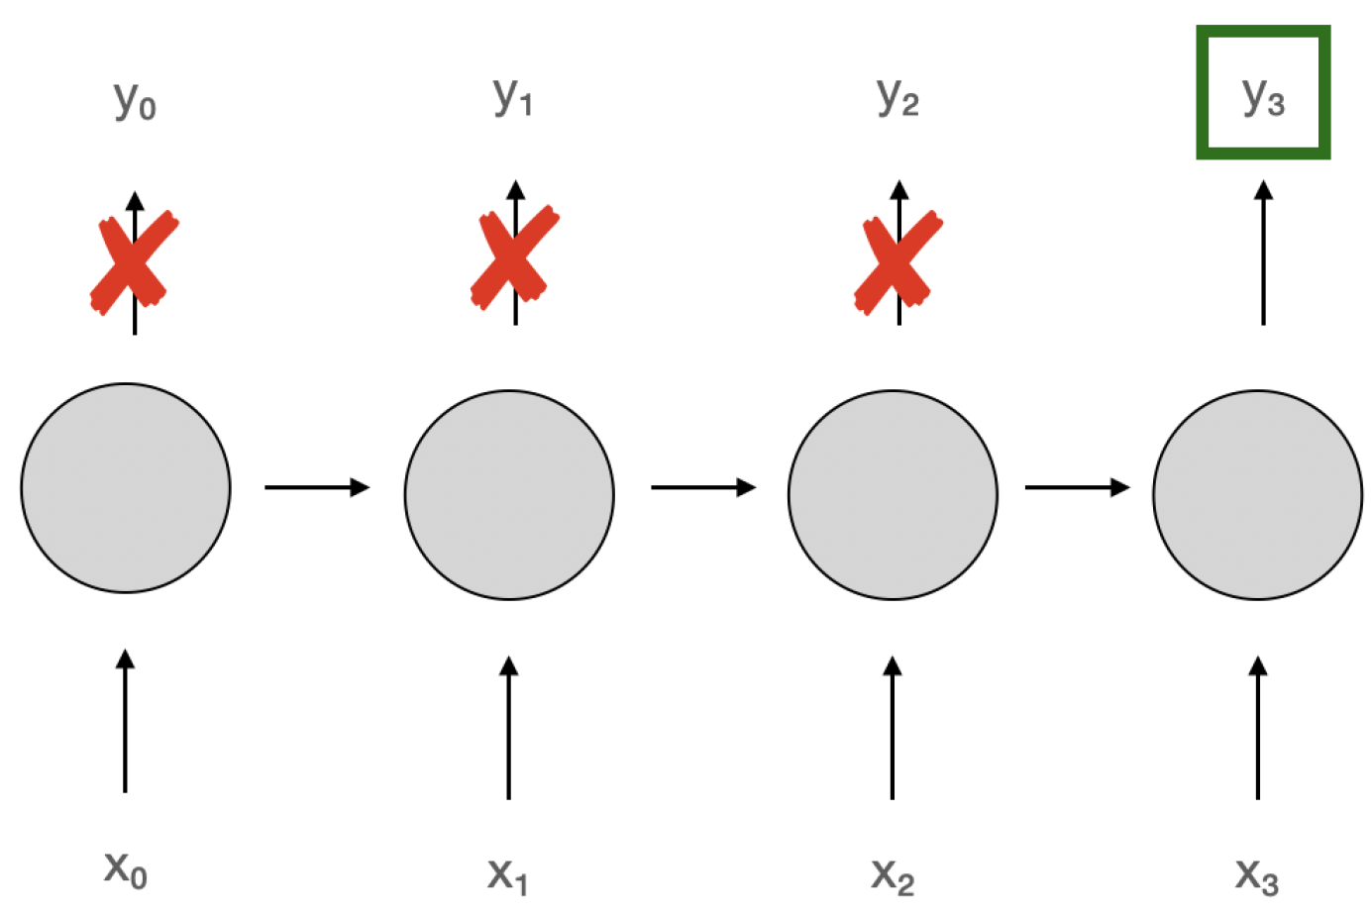
Sequence-to-vector Architecture
Sequence-to-Vector (Seq2Vec) is a neural network architecture designed to transform an entire sequence of data into a fixed-length vector.
Pass sequence as input, use only the last output
Example: Text topic classification
Key Components of Seq2Vec Architecture:
Encoder:
The core component of the Seq2Vec architecture is the encoder, which processes the input sequence (such as a series of words, characters, or features) and condenses it into a fixed-length vector.
The encoder can be a type of Recurrent Neural Network (RNN), such as LSTM (Long Short-Term Memory) or GRU (Gated Recurrent Units), but other models, like Convolutional Neural Networks (CNN) or Transformer-based models, can also be used for encoding sequences.
Fixed-Length Vector:
After processing the entire sequence, the encoder outputs a single vector that captures the essential information of the sequence.
This vector is expected to encode the relevant features or context from the sequence in a compressed form, which can then be used for further tasks.
Global Pooling:
A common technique used to create the fixed-length vector is global pooling, where features from different time steps (or positions in the sequence) are aggregated, typically using mean pooling, max pooling, or sum pooling.
For example, in an RNN-based encoder, the hidden states at each time step might be combined using pooling to create a single fixed-length vector.
Notes:
The Seq2Vec architecture is designed to convert a sequence of data into a fixed-length vector representation. This vector can then be used for various tasks, such as classification, prediction, or similarity comparison. Seq2Vec models are commonly used in text classification, sentiment analysis, time-series forecasting, and other tasks involving sequential data. The architecture can be based on RNNs, CNNs, Transformers, or other advanced neural network models. While Seq2Vec is efficient and flexible, it may lose some sequence-specific details when compressing long sequences into fixed-length vectors.
4o mini

Slide 13
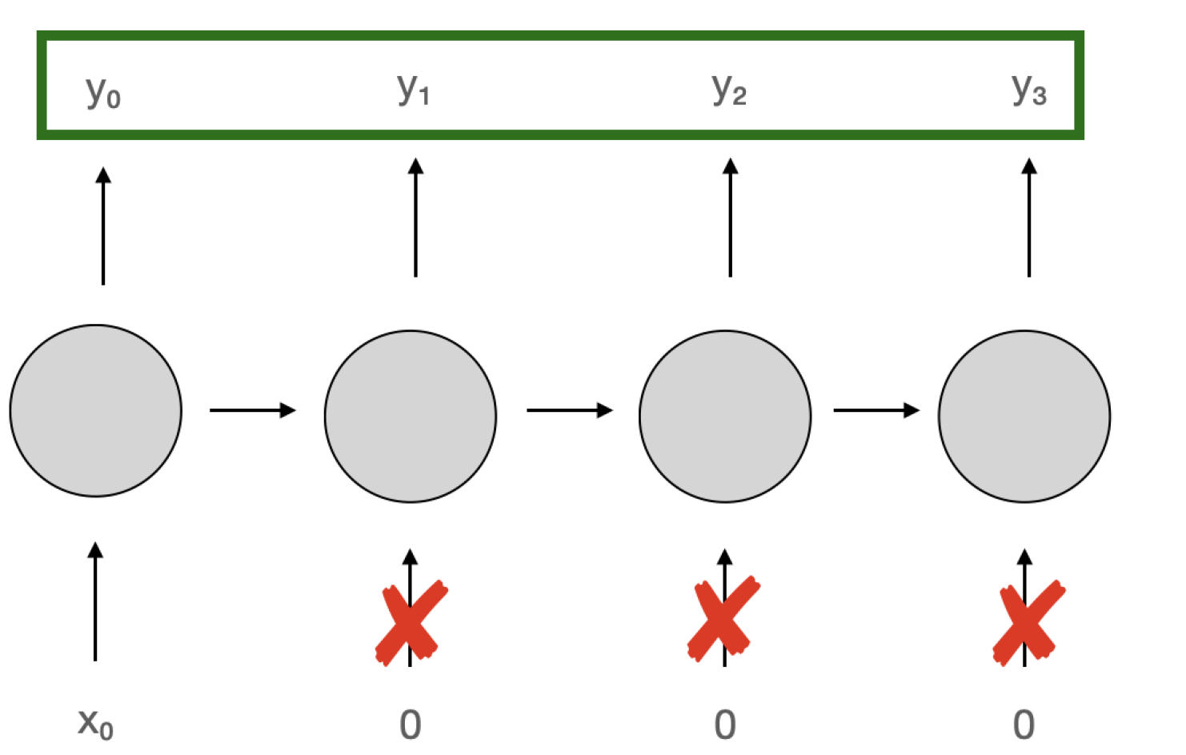
Vector-to-sequence Architecture
The Vector-to-Sequence (Vec2Seq) architecture is a neural network design used to generate an output sequence from a fixed-length input vector. This approach is commonly used when the input data is represented as a single vector containing condensed or abstract information, and the task requires decoding this vector into a meaningful sequence.
Pass single input, use the entire output sequence
Example: Text generation
Key Components of Vec2Seq Architecture:
Input Vector:
The input to a Vec2Seq model is a fixed-length vector, often generated by another model or process (e.g., an encoder in Seq2Seq, a feature extractor from an image, or a latent vector in variational autoencoders).
This vector acts as the compact representation or context of the data from which the sequence will be generated.
Decoder:
The core of the Vec2Seq architecture is the decoder, which generates the output sequence step by step.
Typically, the decoder is implemented using Recurrent Neural Networks (RNNs), such as LSTMs (Long Short-Term Memory) or GRUs (Gated Recurrent Units), though Transformer-based decoders are increasingly used for better scalability and performance.
Generation Process:
The decoder generates the sequence iteratively, predicting one element of the sequence at a time.
At each step, the decoder considers the current state of the network, the fixed input vector, and its own previous output to generate the next element
Notes:
The Vec2Seq architecture maps a fixed-length vector to a sequence of outputs by using a decoder to generate the sequence step by step. It is widely used in tasks like image captioning, speech synthesis, and text generation. Advanced techniques such as attention mechanisms and beam search enhance its effectiveness, especially for complex or long sequences. While the architecture is highly versatile, its performance relies on the quality of the input vector and the decoder's ability to maintain sequence coherence.

Slide 14
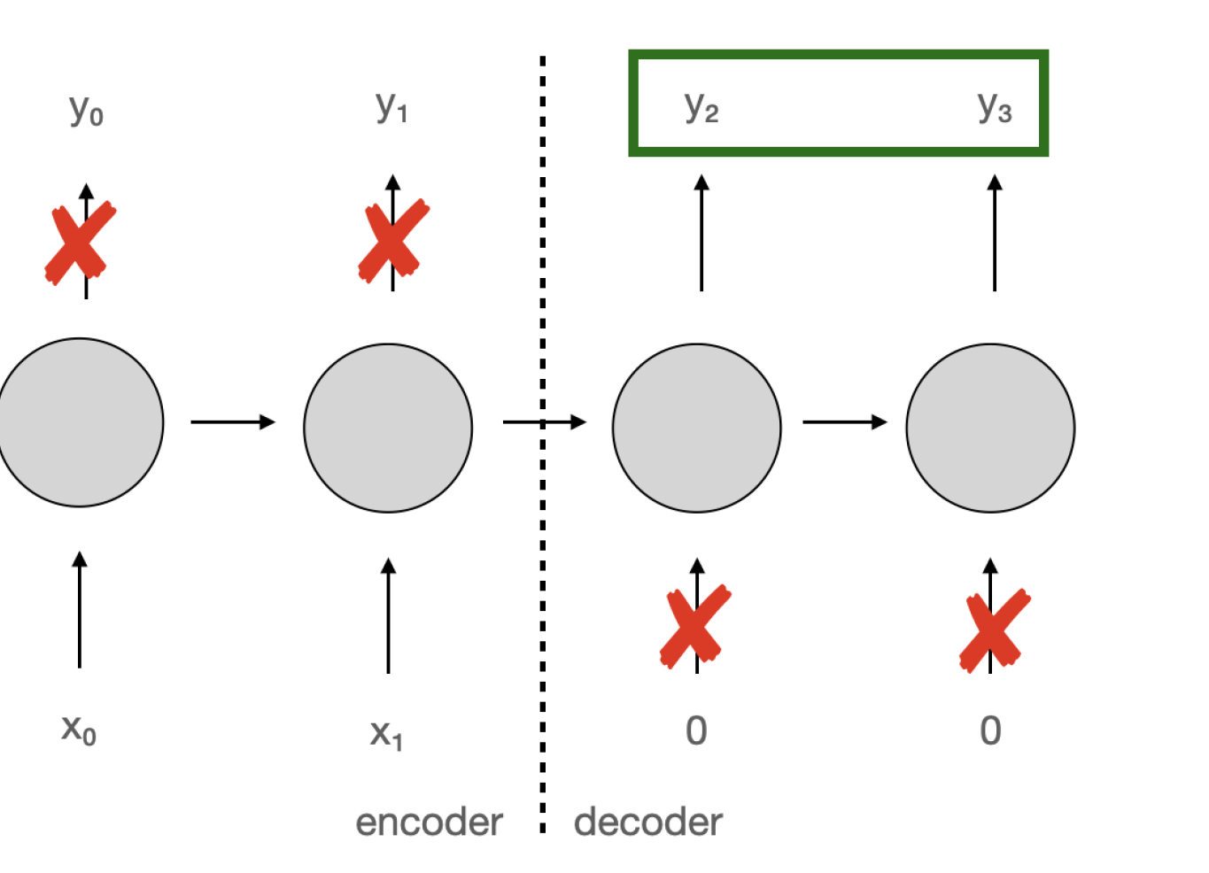
Encoder-decoder architecture
The Encoder-Decoder architecture processes the entire input sequence before starting to generate the output sequence. This approach is especially useful in tasks like machine translation, where understanding the entire input is critical before producing meaningful outputs.
Pass entire input sequence, only then start using output sequence
Example: Machine translation
Steps in the Architecture
Input Sequence Encoding:
The encoder processes the entire input sequence one token at a time and condenses it into a context vector or a sequence of hidden states.
No output is produced during this phase; the model only encodes the input sequence.
Context Vector:
This fixed-length representation (or sequence of vectors in advanced models) serves as a summary of the entire input sequence.
Decoding Output Sequence:
After the entire input sequence is encoded, the decoder uses the context vector to generate the output sequence.
Generation begins one token at a time, using the context and the previously generated tokens.

Slide 15
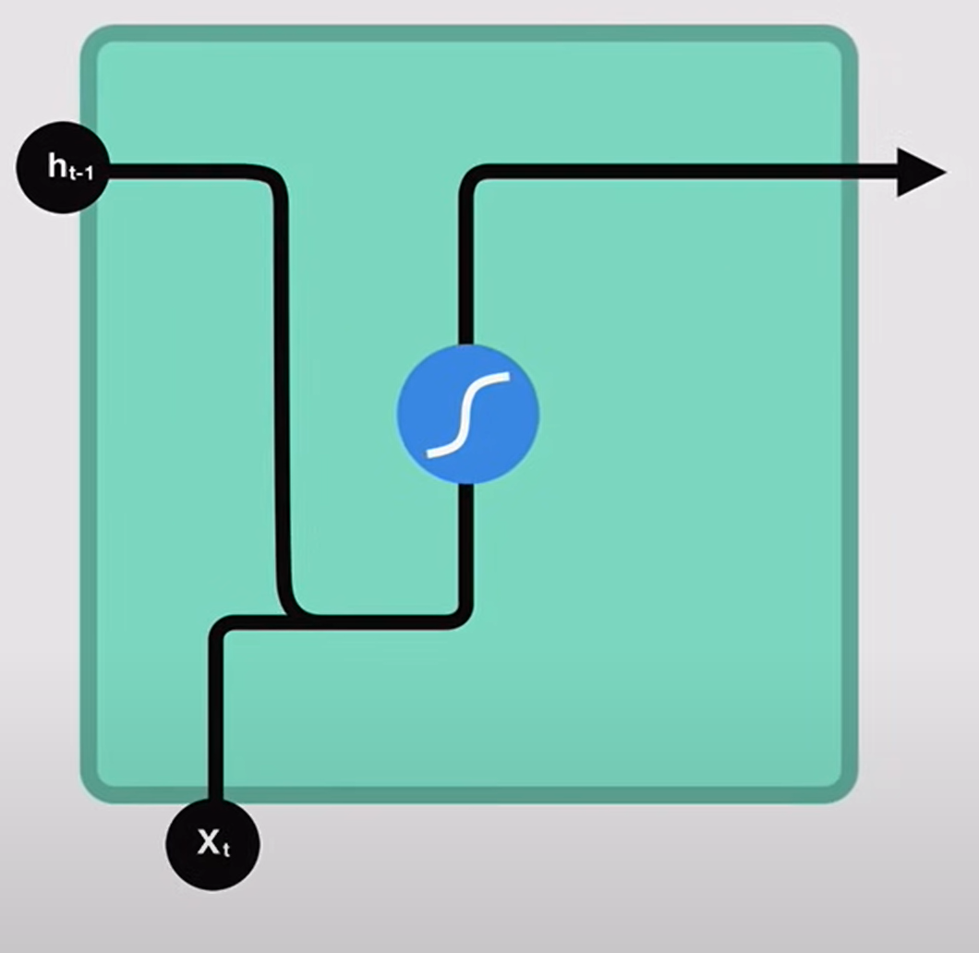

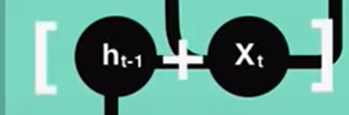
RNN

Slide 16
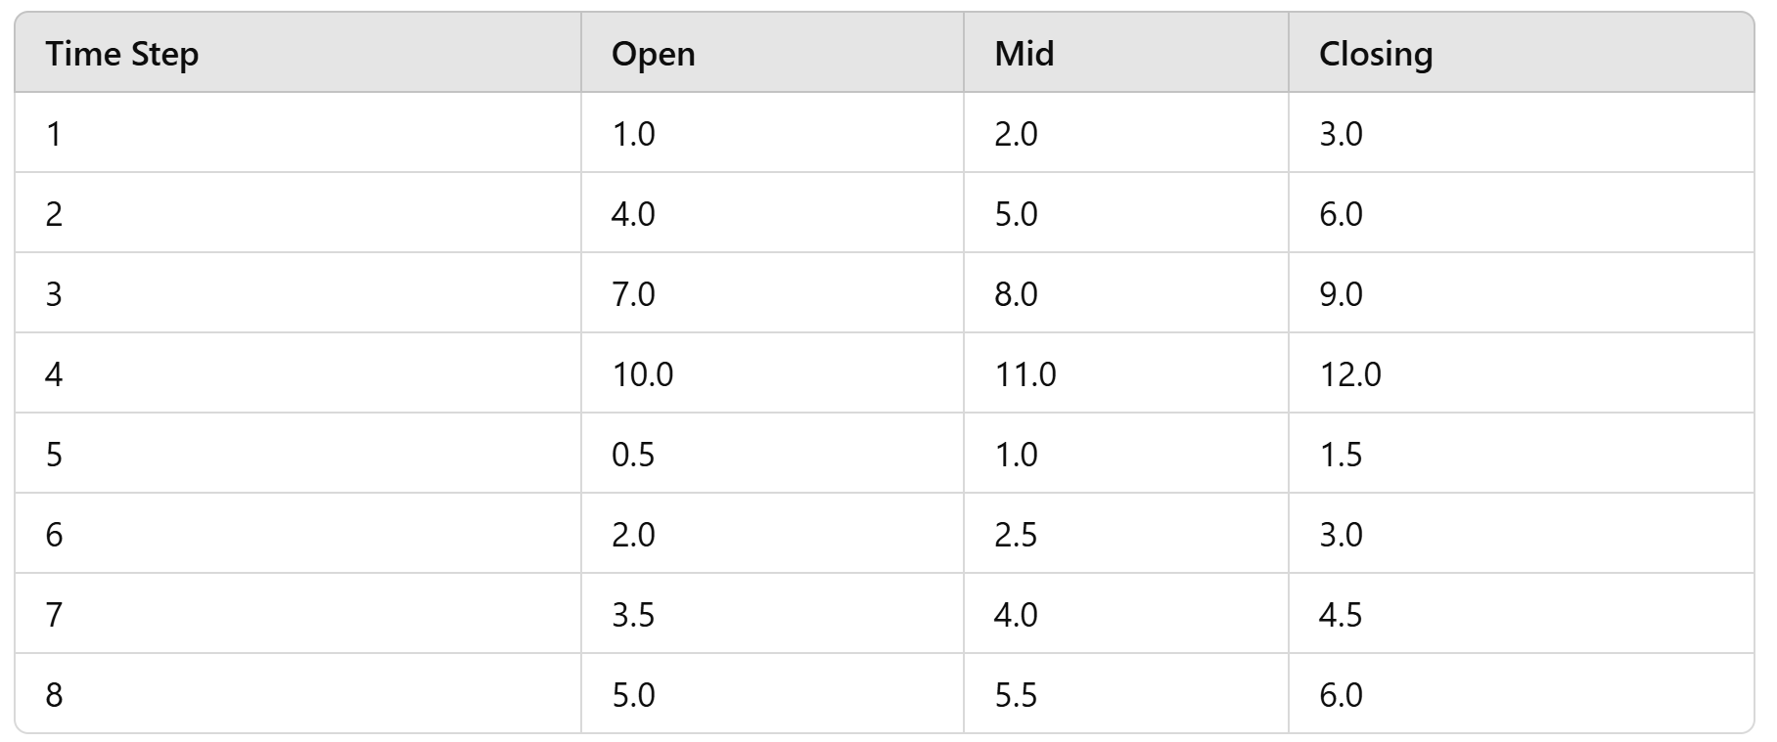
Input Tensor:
The input tensor shape (2,4,3)
Batch size: 2 sequences.
Sequence length: 4 time steps per sequence.
Input size: 3 features per time step.
[
[[1.0, 2.0, 3.0], [4.0, 5.0, 6.0], [7.0, 8.0, 9.0], [10.0, 11.0, 12.0]], # First sequence
[[0.5, 1.0, 1.5], [2.0, 2.5, 3.0], [3.5, 4.0, 4.5], [5.0, 5.5, 6.0]] # Second sequence
]

Slide 17
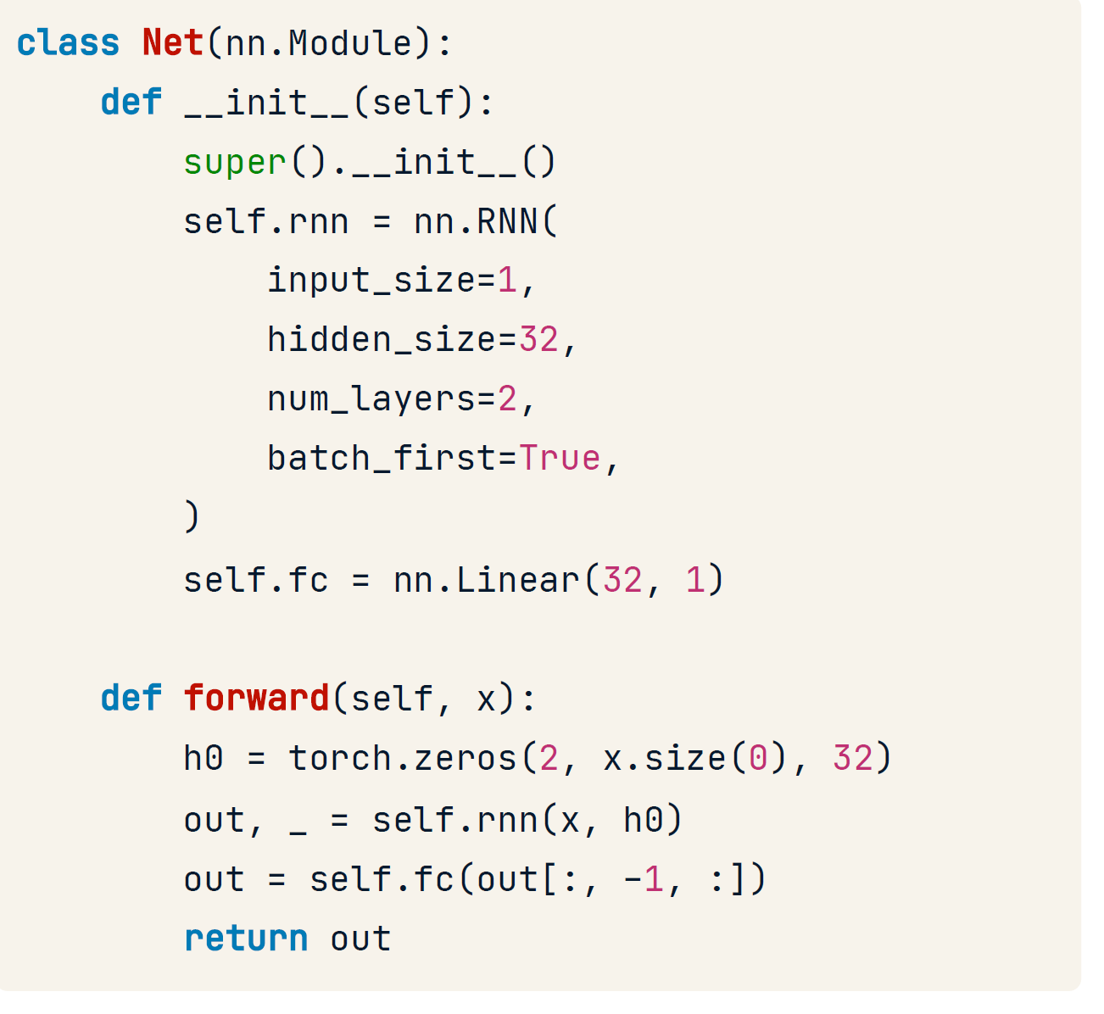
RNN in PyTorch
The code defines a simple RNN model with two layers, processes input data through the RNN, and then outputs a single value through a linear layer.
Define model class with __init__ method
Define recurrent layer, self.rnn
Define linear layer, fc
In forward() , initialize first hidden state to zeros
Pass input and first hidden state through RNN layer
Select last RNN's output and pass it through linear layer
3
The Net class defines an RNN with:
input_size=3: Each time step has 3 features.
hidden_size=32: The RNN has 32 hidden units.
num_layers=2: The RNN has 2 layers.
A fully connected layer that maps the RNN's output (32 hidden units) to 1 output.

Slide 18
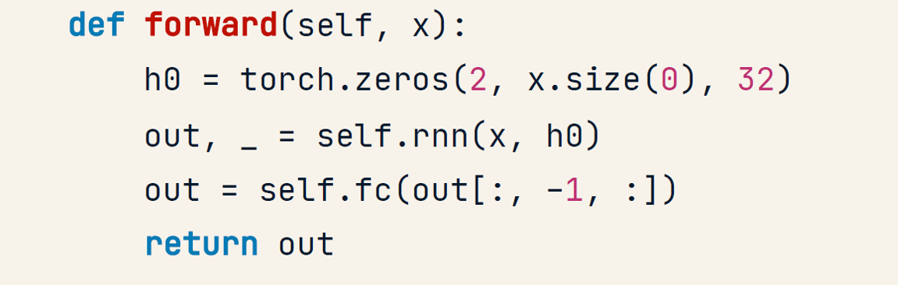
x: The input tensor of shape (batch_size, sequence_length, input_size).(2,4,3)
h0: The initial hidden state of shape (num_layers, batch_size, hidden_size)(2,2,32) The RNN returns two things: out: The output tensor containing the hidden states at each time step. _: The final hidden state (ignored this by assigning it to _).
Initial Hidden State (h0):
Shape :(2, 2, 32)
The RNN needs an initial hidden state to start processing the sequence. If we don't provide one, the RNN will initialize it randomly. it is manually initialized with zeros.
RNN Output:
The RNN processes the sequences and outputs a tensor of shape (2, 4, 32), representing the hidden states for each time step.
The code takes the output of the last time step for each sequence (out[:, -1, :]), which has a shape of (2, 32).

Slide 19
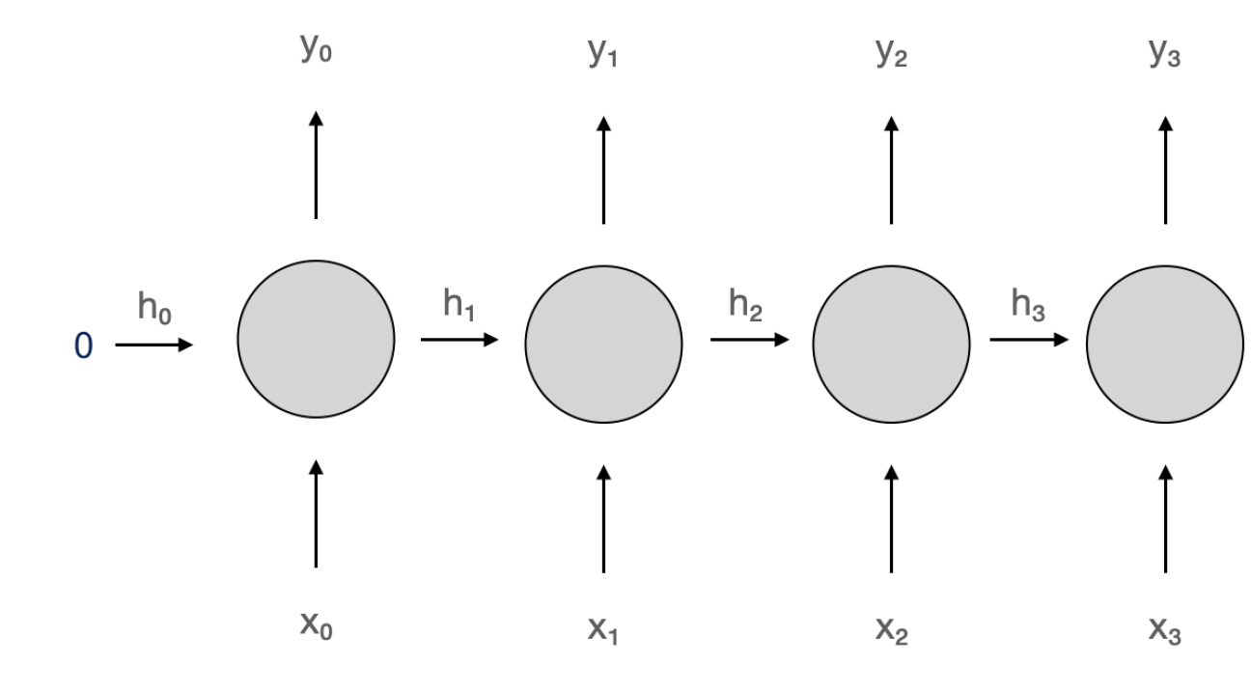
LSTM and GRU cells
Recurrent Neural Networks (RNNs) are designed to maintain a hidden state that serves as a form of memory, enabling the network to process sequential data. However, basic RNN cells suffer from a short-term memory problem due to challenges like vanishing gradients, which make it difficult for the network to retain information over long sequences.
To solve this problem, more advanced cells were introduced:
LSTM (Long Short-Term Memory) cells
GRU (Gated Recurrent Unit) cells
Short-term memory problem
RNN cells maintain memory via hidden state
This memory is very short-term
Two more powerful cells solve the problem:
LSTM (Long Short-Term Memory) cell
GRU (Gated Recurrent Unit) cell

Slide 20
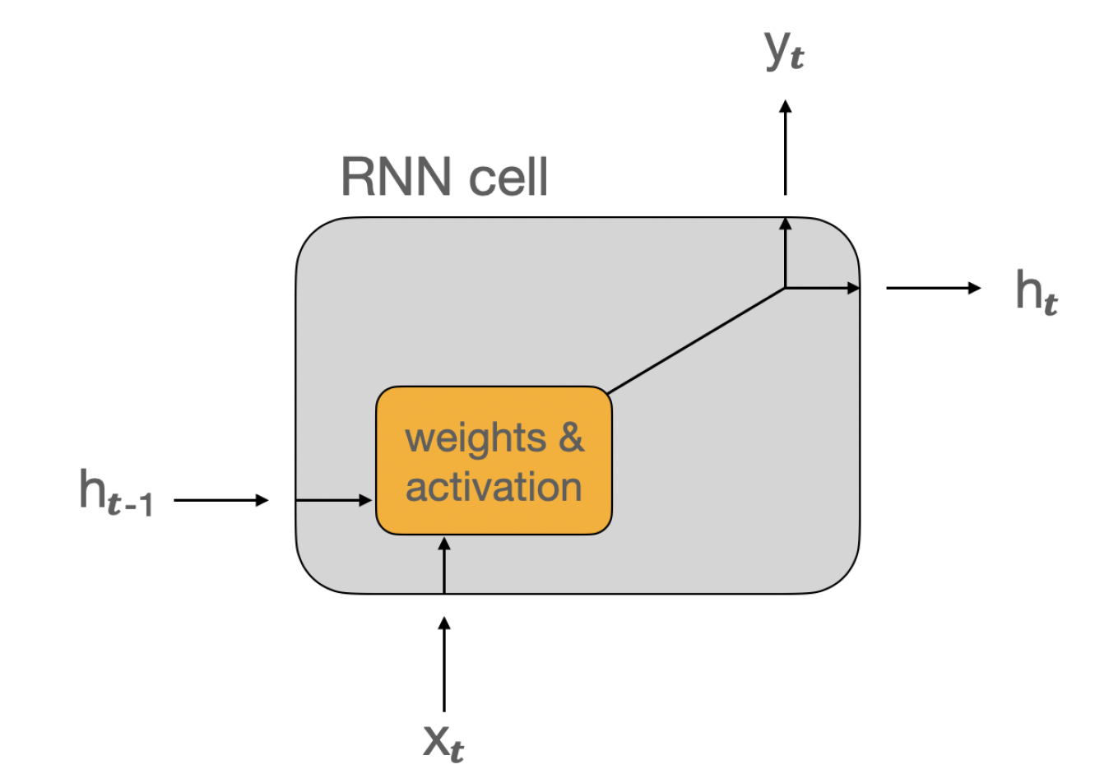
RNN Cell
Two inputs:
current input data x
previous hidden state h
Two outputs:
current output y
next hidden state h

Slide 21
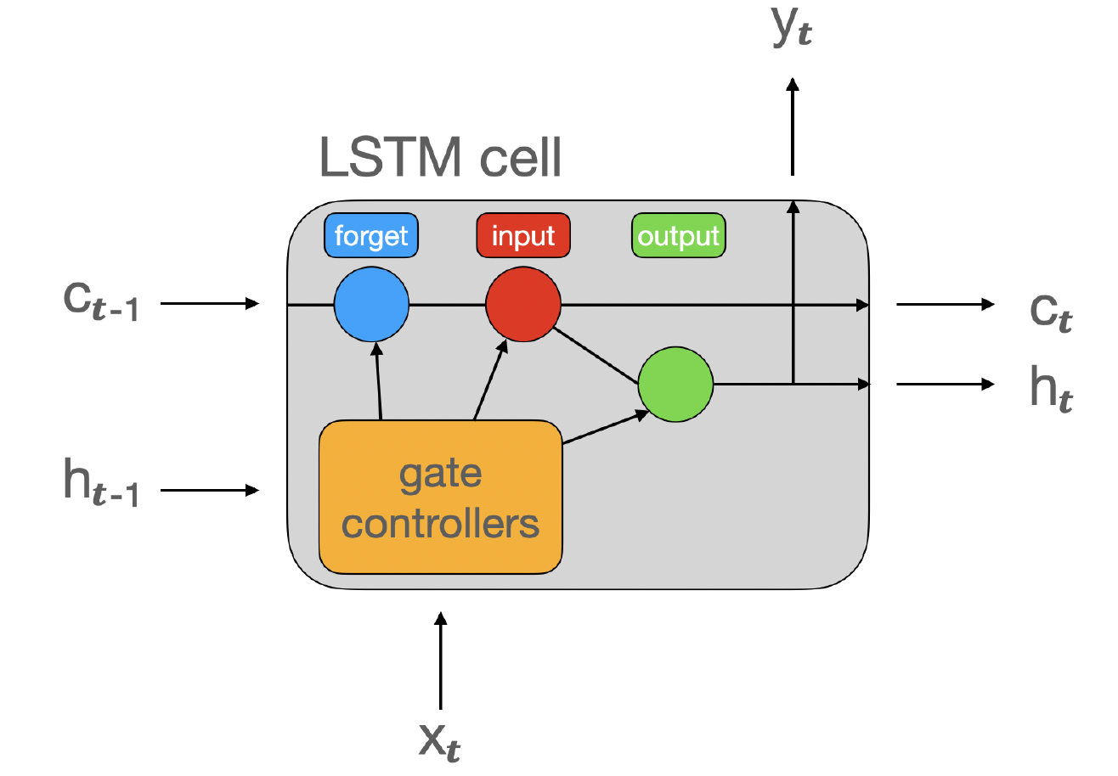
LSTM Cell
The LSTM cell introduces mechanisms to control the flow of information via gates, which allow it to retain and selectively update information over longer sequences. It maintains two states instead of one, enabling it to capture both short-term and long-term dependencies.
Long term Memory
Three inputs and outputs (two hidden states):
h : short-term state
c : long-term state
Three "gates":
Forget gate: what to remove from longterm memory
Input gate: what to save to long-term memory
Output gate: what to return at the current time step
Outputs h and y are the same
Short term Memory

Slide 22
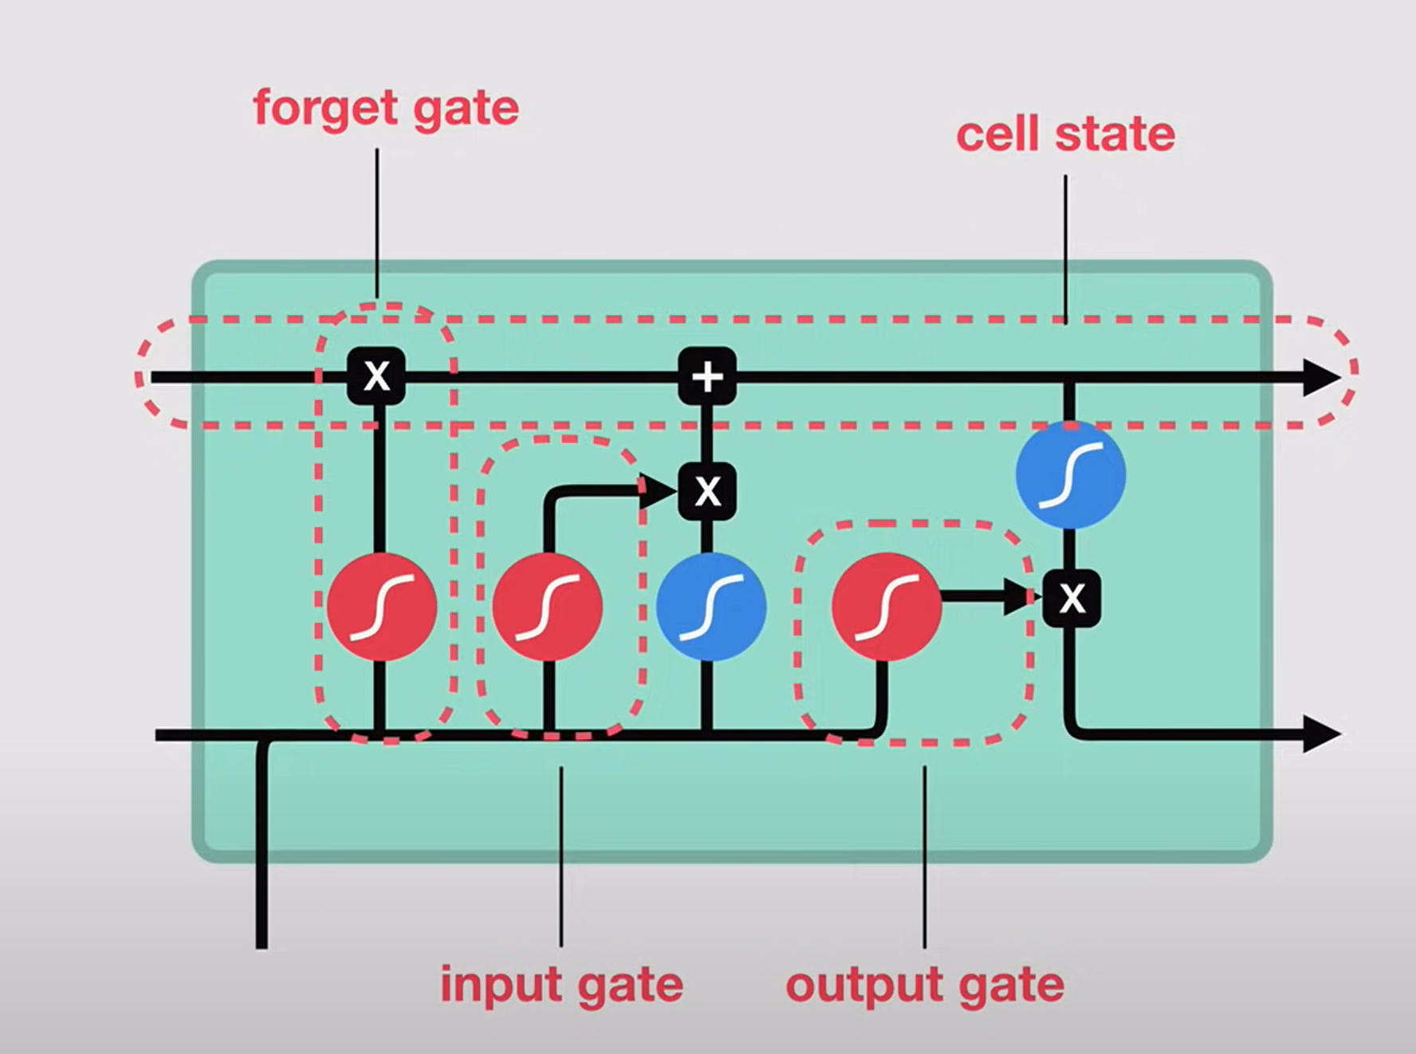
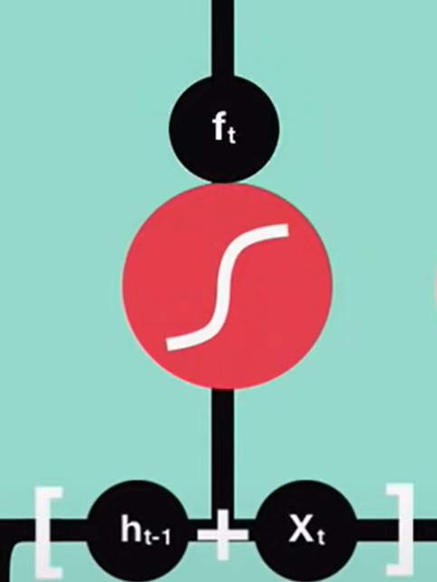
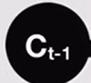
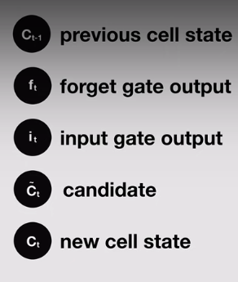
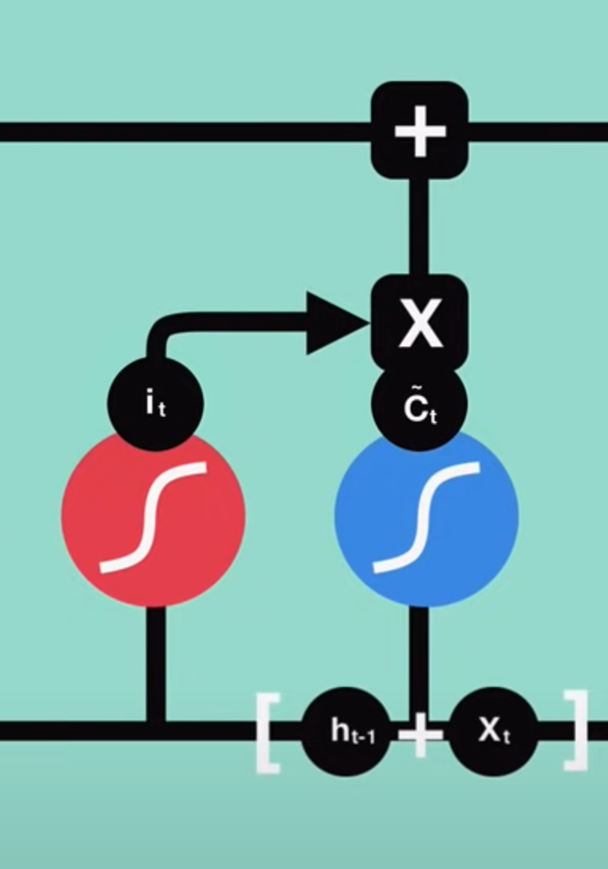

Decide what next hidden state should be
Update cell state to new state
Sigmoid so values are between 0 and 1, values close to 0 are forgotten
Notes:
The sigmoid function, also known as the "gate," is used to determine which information is allowed into the cell state. Specifically, it controls the flow of information through the "input gate," which determines which new information is added to the cell state.
the sigmoid and tanh functions work together to regulate the flow of information through the LSTM network, The sigmoid output decide which information is important to keep from tanh output
allowing it to selectively update its memory while keeping the values in the cell state within a reasonable range. This makes the LSTM network especially effective for tasks that require long-term memory and the ability to selectively forget or remember information over time
The tanh function is used to regulate the values in the cell state. This is important because the cell state can become very large or very small over time, which can make it difficult for the network to learn. The tanh function ensures that the values in the cell state are always within a reasonable range (-1 to 1), which makes it easier for the network to learn

Slide 23
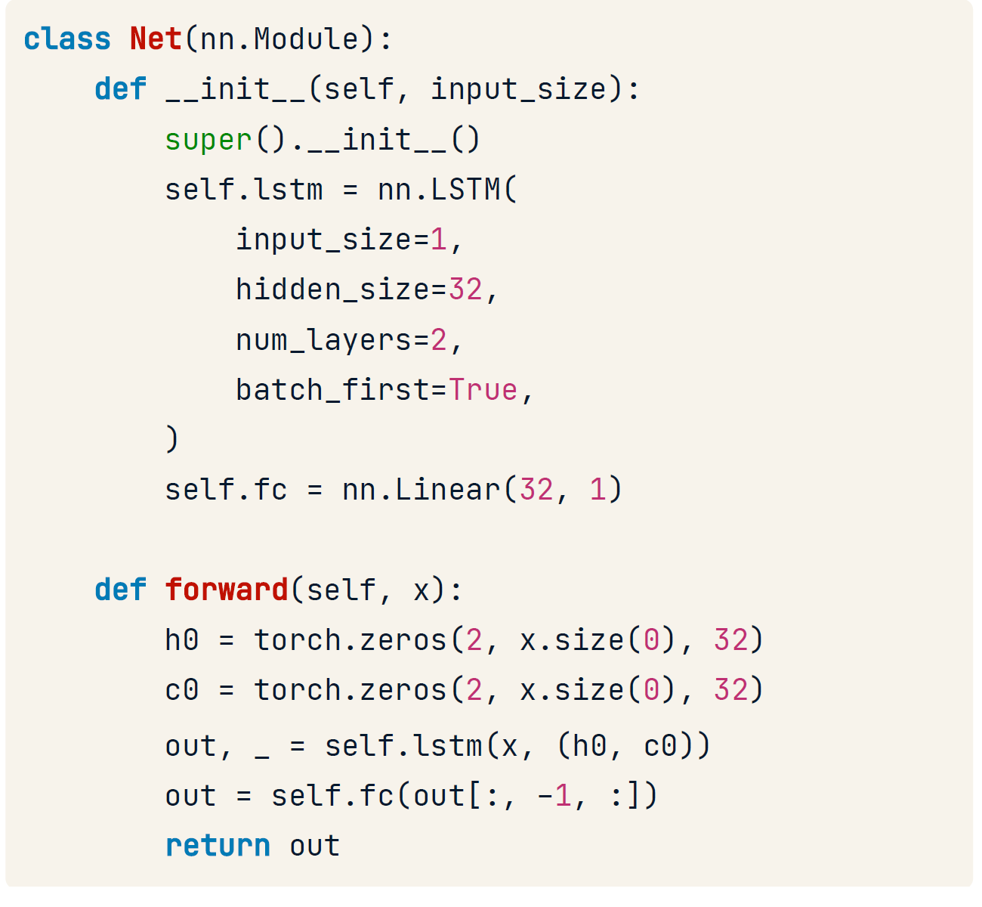
LSTM in Pytorch
__init__() :
Replace nn.RNN with nn.LSTM
forward() :
Add another hidden state c
Initialize c and h with zeros
Pass both hidden states to lstm layer

Slide 24
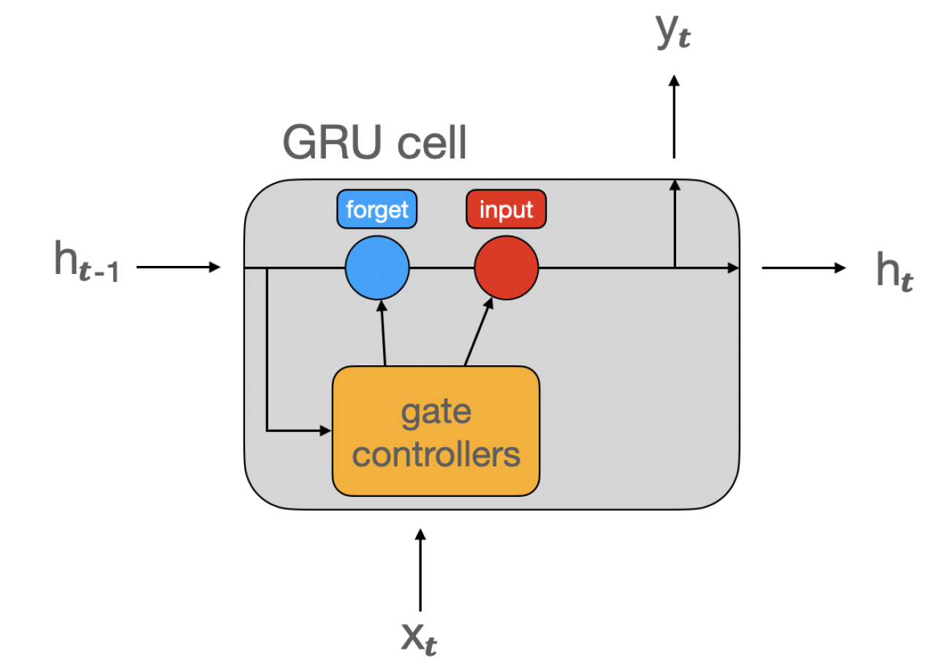
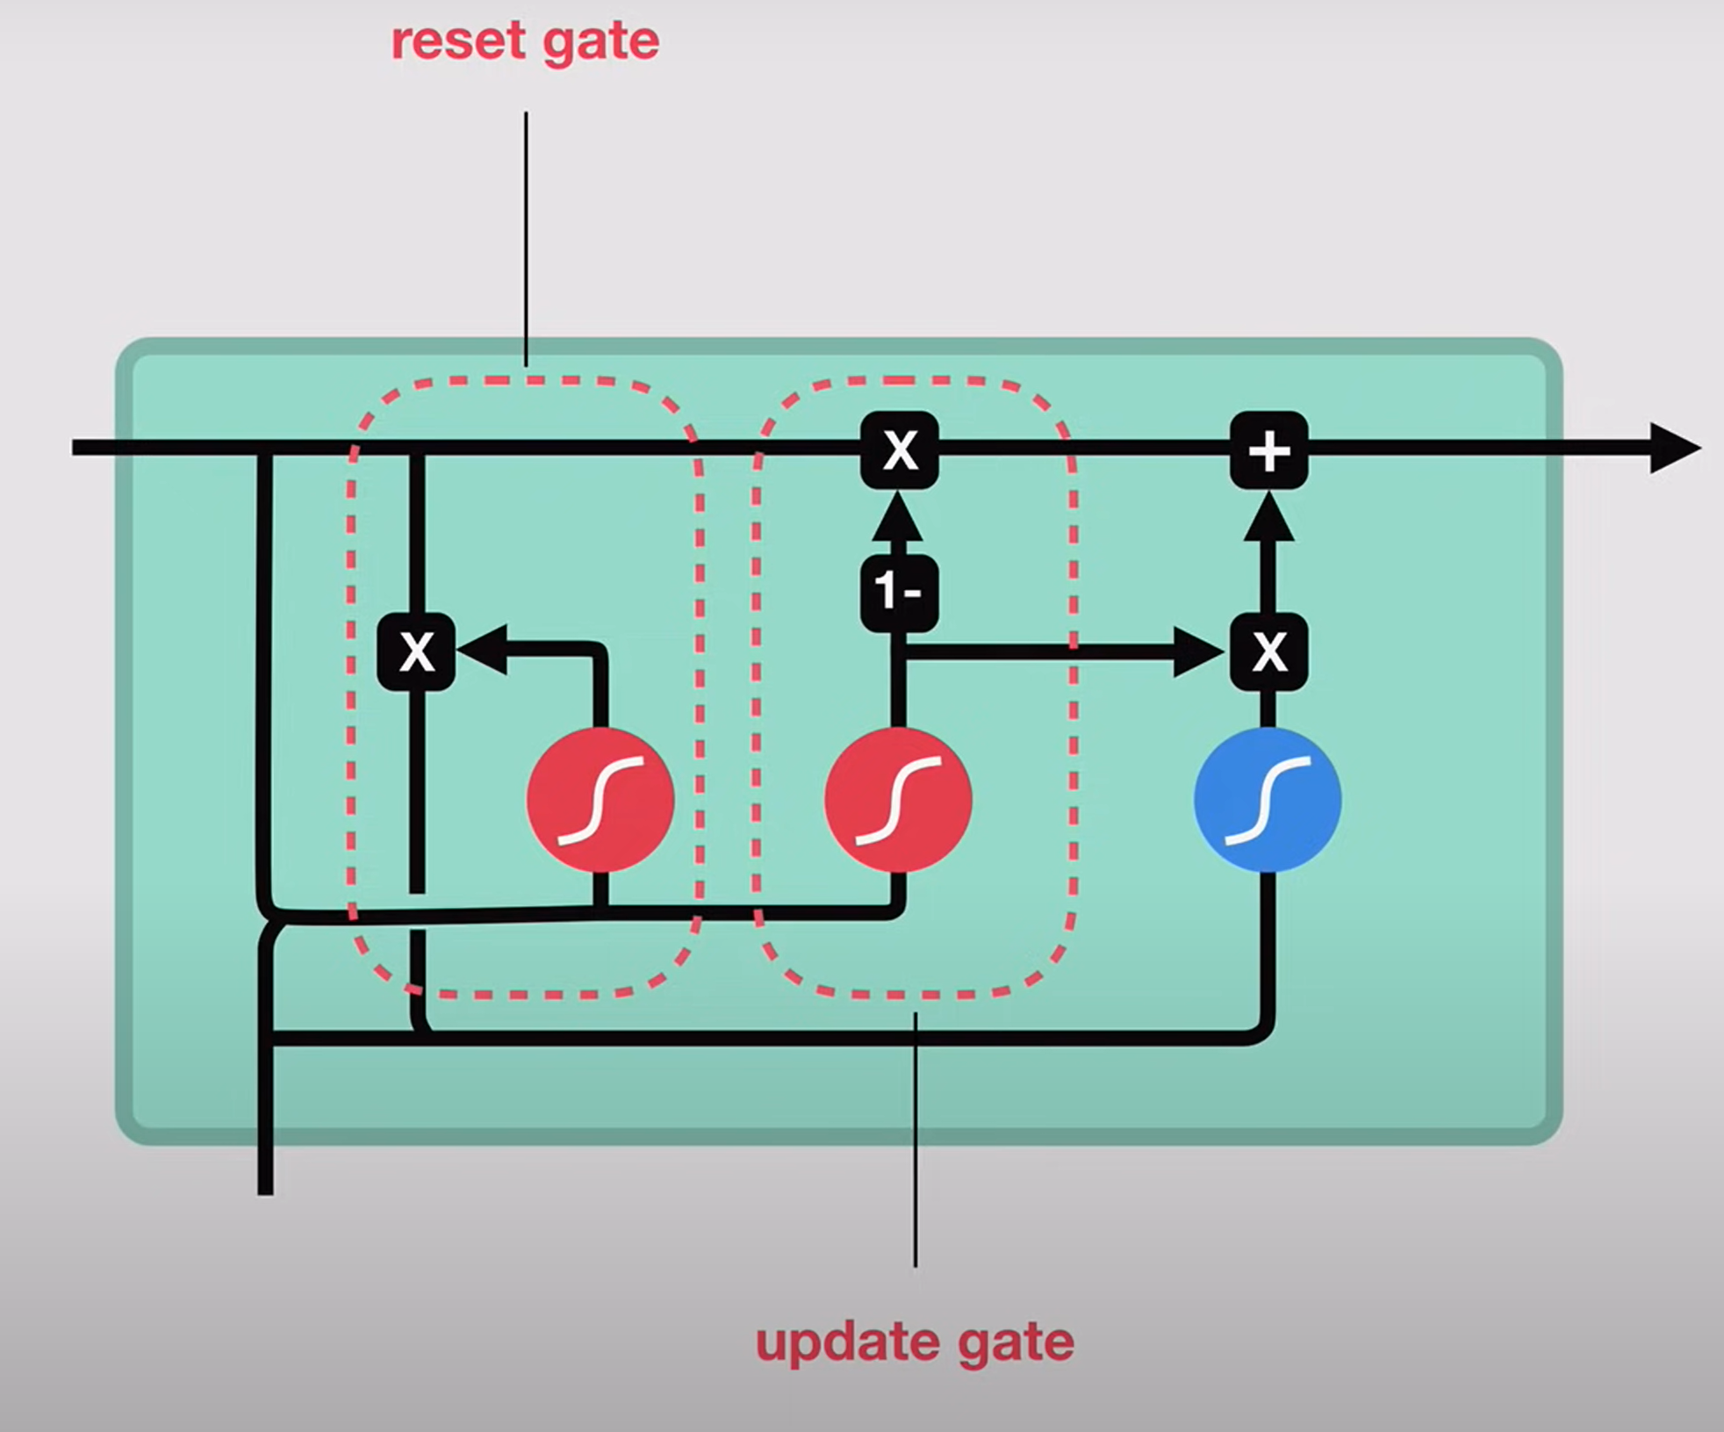
GRU cell
Simplified version of LSTM cell
Just one hidden state
No output gate
he GRU (Gated Recurrent Unit) cell is a variation of the LSTM, designed to achieve similar benefits with a simpler structure.
Key Features of GRU:
No Separate Long-Term State:
The GRU combines the roles of short-term (hth_tht​) and long-term states into a single hidden state.
Two Gates:
Update Gate:
Combines the forget and input gates of LSTM, deciding what information to keep or discard.
Reset Gate:
Decides how much of the previous memory to reset when generating the current state.
GRUs are computationally lighter than LSTMs and often perform similarly on many tasks.

Slide 25
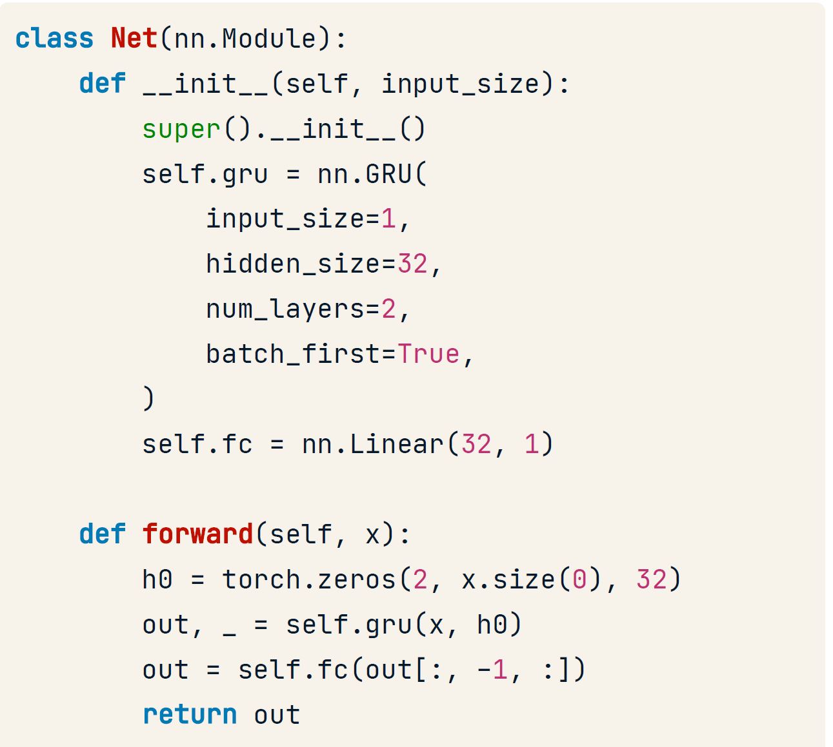
GRU in Pytorch
__init__() :
Replace nn.RNN with nn.GRU
forward() :
Use the gru layer

Slide 26
Should I use RNN, LSTM, or GRU?
RNN is not used much anymore
GRU is simpler than LSTM = less computation
Relative performance varies per use-case
Try both and compare

Slide 27
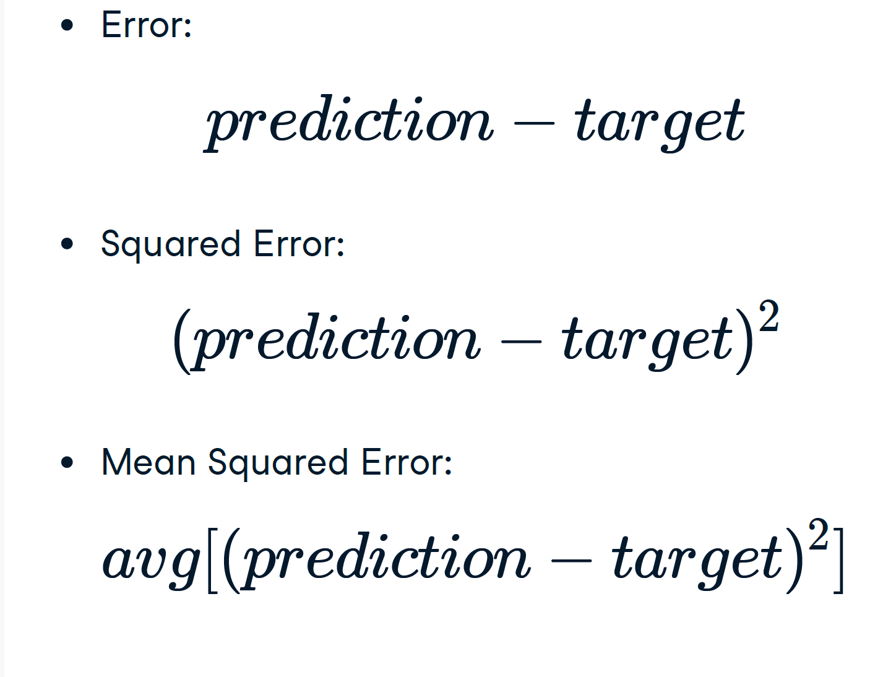
Training and evaluating RNNs
Squaring the error:
Ensures positive and negative errors don’t cancel out
Penalizes large errors more
In PyTorch:
criterion = nn.MSELoss()

Slide 28
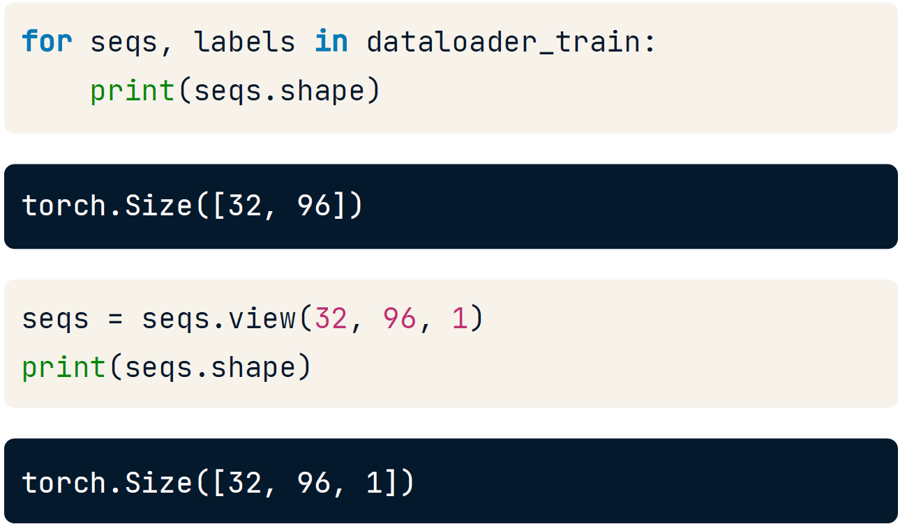
Expanding Tensors
Recurrent layers expect input shape
(batch_size, seq_length, num_features)
We got (batch_size, seq_length)
We must add one dimension at the end

Slide 29
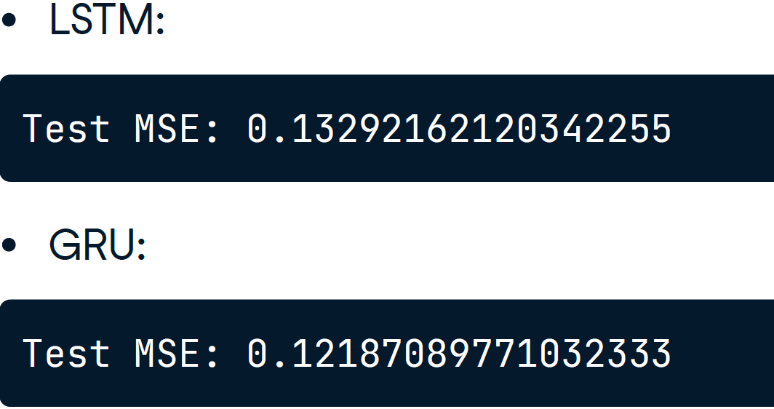
LSTM vs. GRU
GRU preferred: same or better results with less processing power

Slide 30
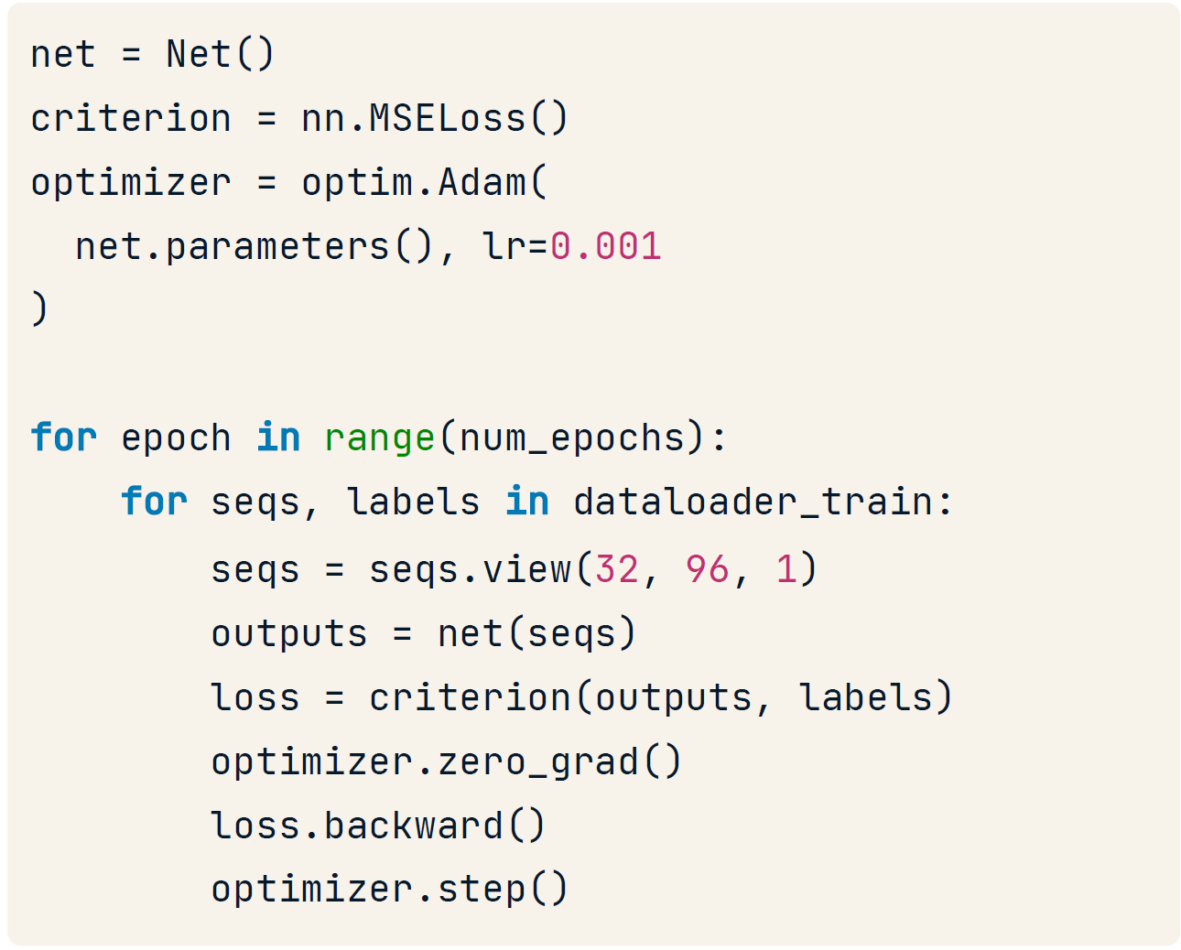
Training loop
Instantiate model, define loss & optimizer
Iterate over epochs and data batches
Reshape input sequence
The rest: as usual

Slide 31

Power of communication

Slide 32

Overcoming nervousness
Confidence-building strategies

Slide 33
Engaging the audience
Make eye contact with your audience to create a sense of intimacy and involvement
Weave relatable stories into your presentation using narratives that make your message memorable and impactful
Encourage questions and provide thoughtful responses to enhance audience participation
Use live polls or surveys to gather audience opinions, promoting engagement and making sure the audience feel involved

Slide 34
Selecting visual aids
Enhancing your presentation

Slide 35
Effective delivery techniques
This is a powerful tool in public speaking. It involves varying pitch, tone, and volume to convey emotion, emphasize points, and maintain interest:
Pitch variation
Tone inflection
Volume control
Effective body language enhances your message, making it more impactful and memorable:
Meaningful eye contact
Purposeful gestures
Maintain good posture
Control your expressions

Slide 36
Navigating Q&A sessions
Know your material in advance
Anticipate common questions
Rehearse your responses
Maintaining composure during the Q&A session is essential for projecting confidence and authority. Consider the following tips for staying composed:
Stay calm
Actively listen
Pause and reflect
Maintain eye contact

Slide 37

Speaking impact
Your ability to communicate effectively will leave a lasting impact on your audience
Effectively communicating involves not only delivering a message but also resonating with the experiences, values, and emotions of those listening

Slide 38
Dynamic delivery
Learn to infuse energy into your delivery to leave a lasting impression.
One of the goals of effective communication is to motivate your audience.
Metric | Measurement | Target | Actual
Audience attendance | # of attendees | 150 | 120
Engagement duration | Minutes | 60 | 75
Q&A interaction | # of questions | 10 | 15
Positive feedback | Percentage (%) | 90 | 95
Rate of information retention | Percentage (%) | 80 | 85

Slide 39
Final tips & takeaways
Consistent rehearsal
Strengthen your familiarity
Refine delivery style
Pacing, tone, and emphasis
Timing and transitions
Aim for seamless, professional delivery
Practice audience
Enlist colleagues to listen & provide feedback
Seek feedback
Reflect on performance
Explore new techniques
Set personal goals
Iterate and adapt

Slide 40
Speaking engagement metrics
Impact factor | Measurement | Target | Achieved
Audience interaction | Percentage (%) | 85 | 88
Knowledge retention | Percentage (%) | 75 | 80
Post-presentation surveys | Average rating | 4.2 | 4.5
Referral rate | Percentage (%) | 10 | 12
Collaboration opportunities | # of opportunities | 8 | 10

Slide 41
Thank you
Brita Tamm
502-555-0152
brita@firstupconsultants.com
www.firstupconsultants.com

